Slide 1



Startup Fail Analysis:
Unveiling the Patterns Behind Startup Failure
By : Septi W

Slide 2

Summary:
Startup is a business that has just been established and grown supported by digital services and has also become an important element of innovation systems and economies around the world. The Startup ecosystem is growing very rapidly and still needs a lot of funding to operate with a minimalist working group. And to monitor startup performance, it is important to analyze what makes a Startup successful and how to determine its success.
Goals:
The goal to be achieved is to determine whether a StartUp will be successful or not.
Objective:
The objective is to analyze startup behavior based on several variables, determine what variables affect startup success the most, then build a model that can predict the success of a StartUp.

Slide 3



BUSINESS UNDERSTANDING
As a tech consultant company. Our stakeholders find that most of our client is the new startup that worried that they will fail so fast.
Get some information about what is the biggest cause of startup failure.
What recommendation we can give to the most of our client, so we have the same foundation for the same problem?
What is the key of the success startups? So we can give some suggestion to our client.

Slide 4

WHAT HAPPENED?
According to the Bureau of Labor Statistics BLS, ⅕ of startups fail within their first year.
And up to 65% of startups will fail within 10 years of opening for businesses.
source :
https://www.forbes.com/advisor/business/software/startups-failure-rate/

Slide 5
WHY DID IT HAPPEN?
Source 1
38% of startup failures occur due to financial issues
35% of businesses fail due to lack of market need
20% of businesses fail due to industry competition
19% of businesses fail due to unsuccessful business model
18% of businesses fail due to legal challenges
Source 2
Reason 1: Lack of financing or investors 47%
Reason 2: Running out of cash 44%
Reason 3: Lack of market demand or poor timing
Reason 4: People problems—Clashing between leadership, teams, and investors
source :
https://www.forbes.com/advisor/business/software/startups-failure-rate/
source :
https://www.capchase.com/blog/the-top-4-reasons-why-startups-fail-and-how-to-avoid-them

Slide 6
DATA UNDERSTANDING

Slide 7
DATA DESCRIPTION
923 ROWS AND 49 COLUMNS
-unnamed: 0
-state_code
-latitude
-longitude
-zip_code
-id
-state_code.1
-unnamed: 6
-name
-founded_at
-closed_at
-first_funding_at
-closed_funding_at
-milestones
-avg_participants
-is_top500
-labels
-age_first_funding_year
-age_last_funding_year
-age_first_milestone_year
-age_last_milestone_year
-relationship
-funding_rounds
-has_VC
-has_angel
-has_roundA
-has_roundB
-has_roundC
-has_roundD
-funding_total_usd
-object_id
-city:
- is_CA
- is_NY
- is_MA
- is_TX
- is_otherstate
-category_code
- is_software
- is_web
- is_mobile
- is_enterprise
- is_advertising
- is_gamesvideo
- is_ecommerce
- is_biotech
- is_consulting
- is_othercategory
-status
Data Source : https://www.kaggle.com/datasets/manishkc06/startup-success-prediction

Slide 8
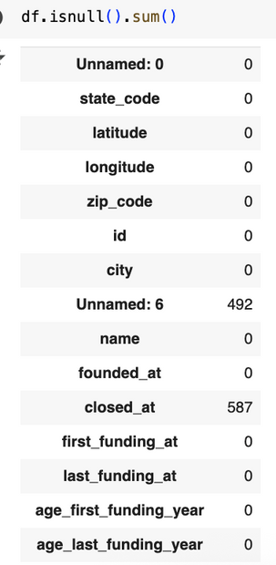
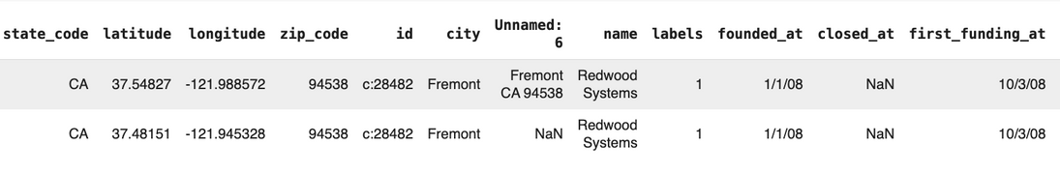
DATA CLEANING
Missing Value:
No data drop due to Missing Value
Handling Duplicated Data:
There is one Duplicate under the same company name

Slide 9
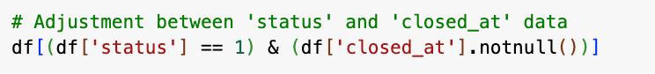
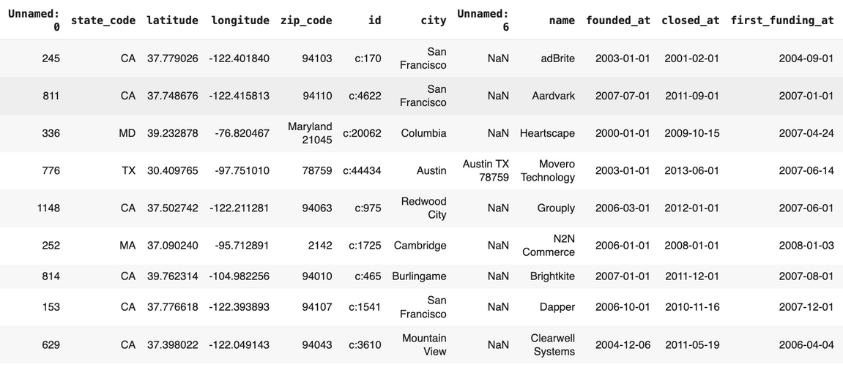
DATA CLEANING
Making Adjustments to the Target (status):
There are 9 data startup that inconsistency between ‘closing_date’ and ‘status’.
Once a startup has a ‘close_at’ date, its final observable status is closed, even if it was acquired earlier.
Anomali data on ‘funding_total_usd:
Upon reviewing the total funding information for Clearwire, we find that it Not Comparable, Clearwire is closer to a corporate-backed telecom venture than to a typical early-stage startup, so it’s not the same “population.”

Slide 10
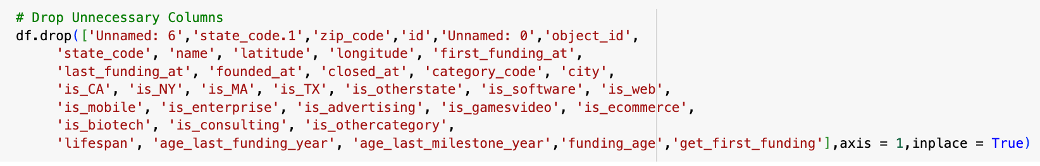
FEATURE ENGINEERING
Making feature extraction to improve model performance, and get rid off from negative value :
'get_first_funding'
'lifespan'
‘funding_age’
‘has_RoundABCD’
‘has_Investor’
‘has_seed’
‘non-funded Startup’
Drop Column
We're gonna drop some columns and anything computed using future information like age_last_funding_year, age_last_milestone_year.

Slide 11
DATA VISUALIZATION
ORIGINAL FEATURE DATASET
FOUNDATIONAL INSIGHTS INTO STARTUP PERFORMANCE

Slide 12
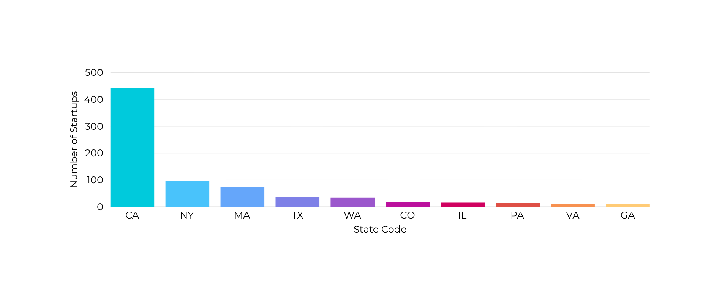
TOP 10 STATES WITH THE HIGHEST NUMBER OF STARTUPS
California (CA) dominates with 441 startups, far more than any other state. Since California is home to Silicon Valley, the global hub for technology and innovation. Many of the world’s most successful tech companies and venture capital (VC) firms are based there. Another factors that explain are : Access to Venture Capital, Talent Pool (world class universities : Stanford, UC Berkeley, Caltech, UCLA), Networking & Infrastructure, Culture of Risk-Taking and Market Size & Diversity for the largest state economies in the world.

Slide 13
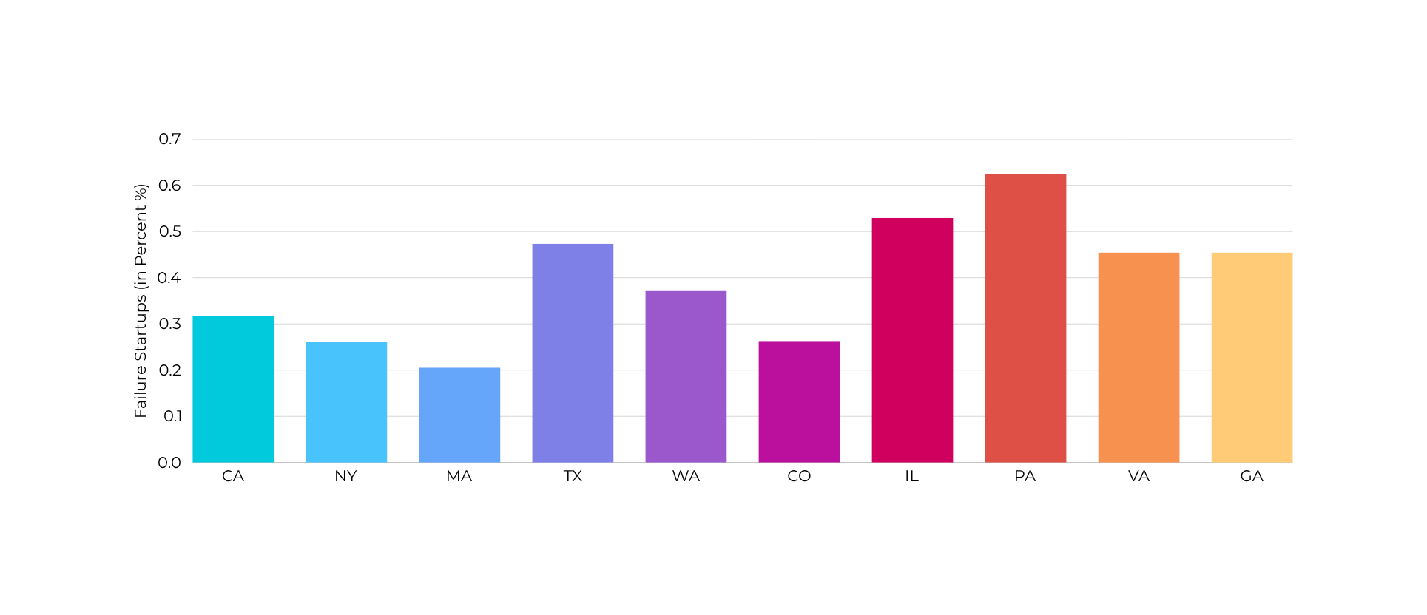
FAILURE RATE OF STARTUPS IN TOP 10 STATES (IN PERCENT %)
States can significantly impact startup failure for several reasons:
Economic Environment: Different regions have varying economic conditions, access to funding, and market demand
Access to Resources: Cities with strong entrepreneurial ecosystems often provide better access to resources such as talent, mentorship, networking opportunities, and investors.
Regulatory Environment: Local regulations, taxes, and business incentives can either support startup growth.
Market Size and Demographics: The size and characteristics of the local market, population, income levels. can affect the viability of a startups
Cultural Factors: The entrepreneurial culture in a city can influence risk tolerance, innovation, and the overall attitude toward startups.

Slide 14
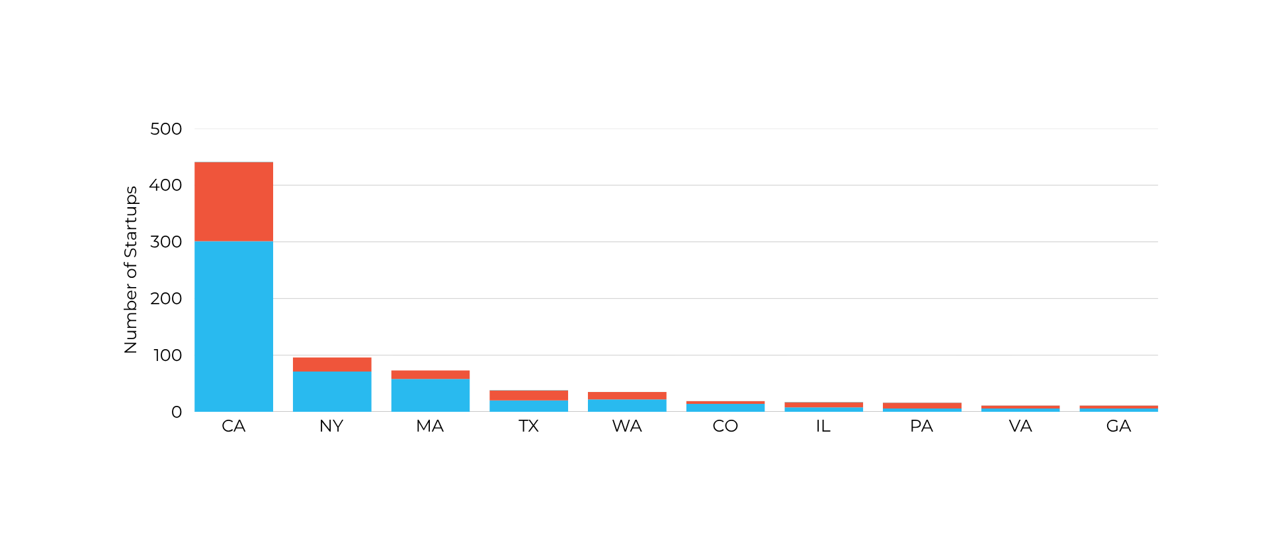
STARTUP SUCCESS VS FAILURE IN THE TOP 10 U.S. STATES
The State is matters, since it reflects ecosystem maturity, access to capital, and market density, which directly influence startup failure risk.
A few states (like CA, NY, MA, TX) dominate startup counts, so naturally, they also contribute the most to both successes and failures.
Startup hubs (California, New York) show large numbers of closures simply because of the high density of ventures.
States with stronger VC ecosystems (CA, MA, NY) tend to have slightly lower failure rates because startups secure more financial backing.
Smaller states, higher risk. States with fewer startups often show higher failure rates since they lack robust investor/talent ecosystems to support struggling companies.

Slide 15
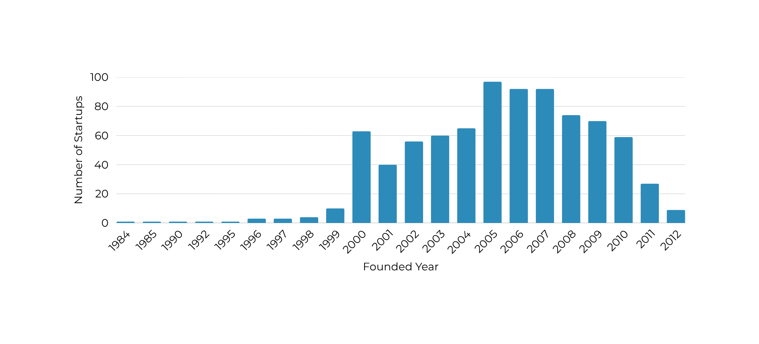
THE ANNUAL GROWTH OF ESTABLISHED STARTUPS
The annual growth in startups surge between year 2005 to 2007 due to main reasons: Global Internet Expansion, the rise of Web 2.0 & Social Media, Early Smartphone Era, Surge in Venture Capital Funding, Lower Barriers to Entry (Cloud & Open Source), and Strong Economic Environment (Pre-2008 Crisis) as the year to Easy access to funding, low unemployment, and high consumer spending created a fertile ground for entrepreneurship

Slide 16
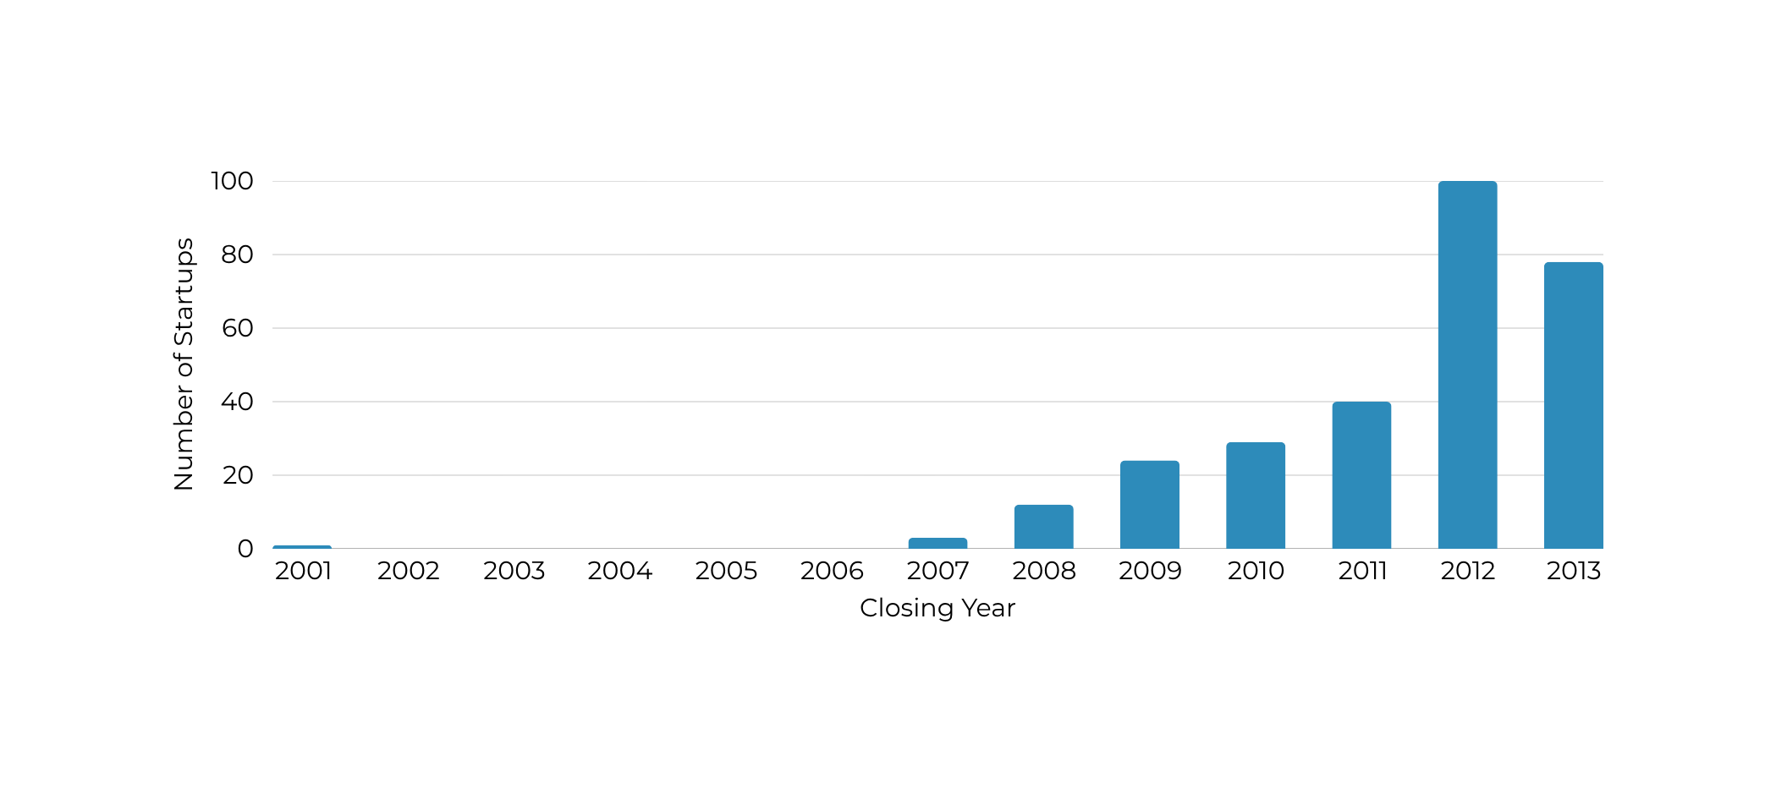
THE YEAR WITH THE MOST STARTUP CLOSURES
The 2012 spike in closures of Startups was a delayed effect of the 2008 crisis and failure of mid-2000s startups to adapt to mobile and survive in saturated markets. Also many of those companies that couldn’t achieve profitability or secure new funding had to close after had 5–7 years of runway. On the other hand, several factors contributed to startup failures, including: Market Saturation, Economic Uncertainty, and Shift in Technology Trends.

Slide 17
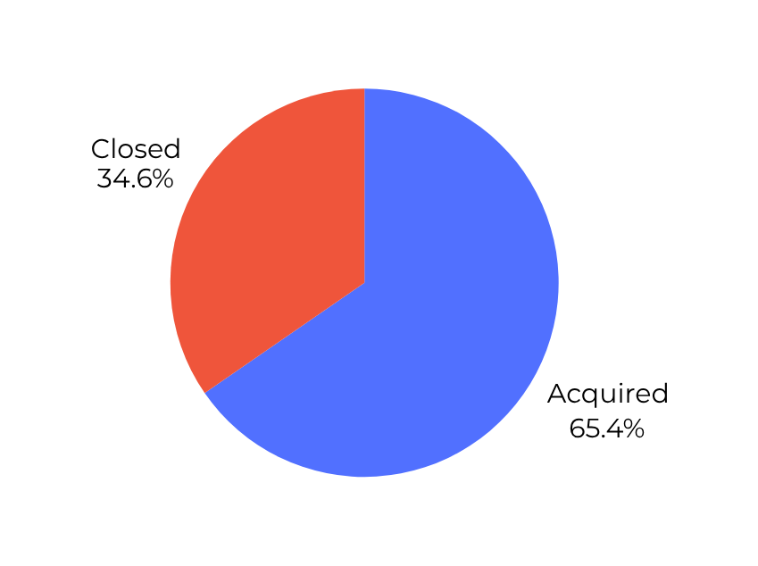
HOW MANY STARTUPS ARE STILL OPERATING
65.4% of the startups are still operating (Acquired), 34.6% of the startups have shut down (Closed)
Survival rate is relatively high, about two-thirds of Startups are still alive, which is notable because real-world startup failure rates are often higher. This may reflect a selection of startups that were better funded or supported.
Failure is still significant, around 1 in 3 startups failed, since Startups still face a high risk of shutting down.

Slide 18
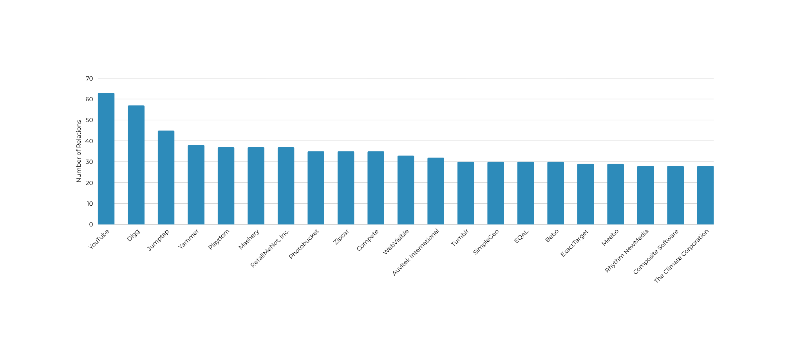
TOP 20 STARTUPS BY NUMBER OF RELATIONSHIPS
YouTube stands out with approximately ~63 relationships, leading the pack, followed closely by Digg and Jumptap among the top three. This impressive number of connections indicates robust ties with investors, strategic partnerships, and a strong network of talent, underscoring YouTube's influential position in the industry. Startups with more relationships tend to scale faster, access more funding, and have higher acquisition chances.
Do relationships matter to startups, lets find out

Slide 19
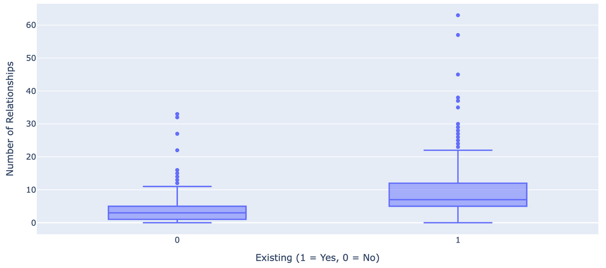
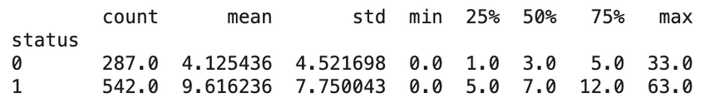
PROFESSIONAL RELATIONSHIPS VS. EXISTING STARTUPS
We found that startups with a robust network of relationships tend to have higher survival rates. Those with more than 20 professional relationships are especially well-positioned for success. But, it's crucial to understand that survival is not solely dependent on connections. Innovation and adaptability are equally vital.
While a strong network can facilitate funding and partnerships, it can also introduce pressure without guaranteeing long-term sustainability. Take WebVisible and Auvitex have failed because they couldn't keep pace with rapidly changing markets, faced intense competition in low-margin environments, and struggled to adapt to evolving technologies.

Slide 20
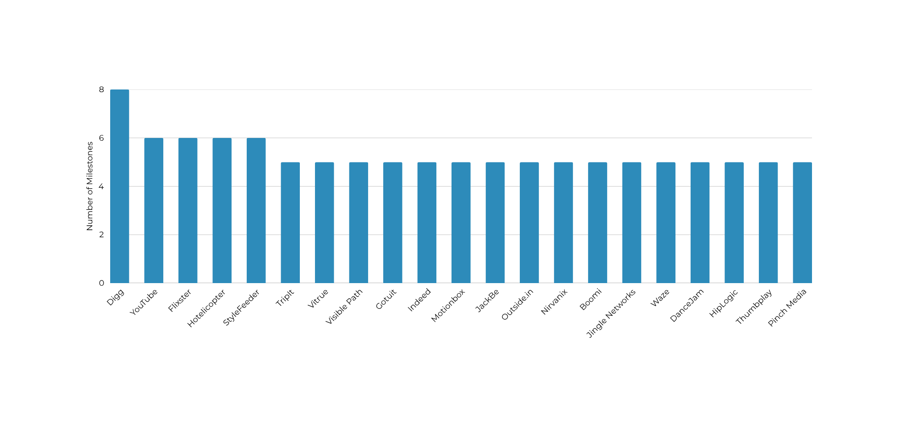
TOP 20 STARTUPS BY NUMBER OF MILESTONES
Milestones in a startup are key events or achievements that signify important progress toward the company’s goals.
Milestone activity are : funding rounds, product launches, product evolution, partnerships, etc. Digg leads with 8 milestones, followed by YouTube, Flixster, Hotelicopter, and StyleFeeder with 6 milestones. This suggests that they achieved or announced more significant events (funding rounds, product launches, partnerships, etc.) compared to the other startups.
Do Milestones impact the success or failure of startups, Lets find out!

Slide 21
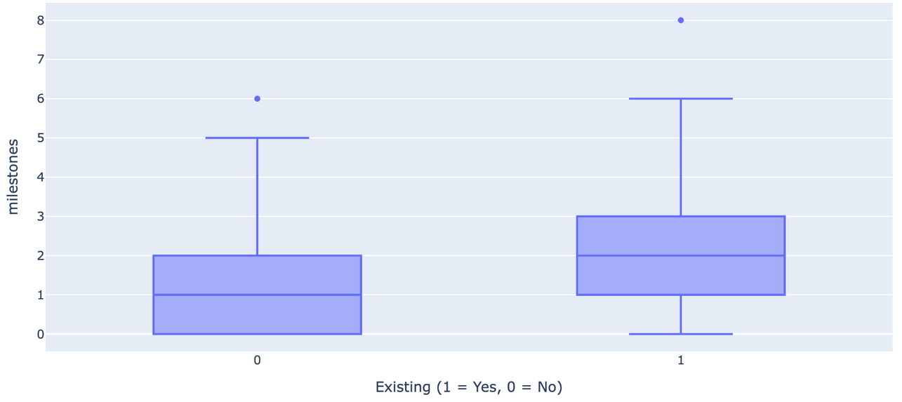
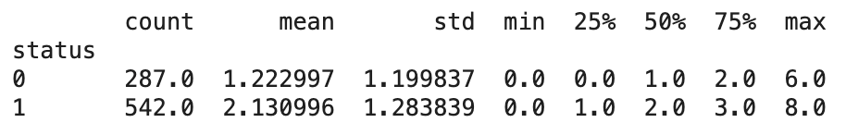
PROFESSIONAL MILESTONES VS. EXISTING STARTUP
Closed Startups has = 1 Median Milestone, while Acquired Startup has double in amount. On average, Acquired startups have 74% more milestones than Closed ones
Startups that are still existing tend to have more professional milestones recorded (higher median and mean)
Acquired startups are more active in achieving milestones compared Closed ones, which may indicate that professional milestones play a role in startup survival. but milestones are not guarantee, since some startups with many milestones still fail, while some with few milestones survive.

Slide 22
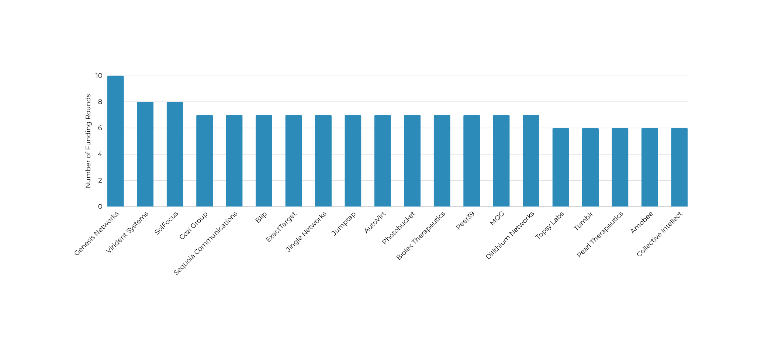
TOP 20 STARTUPS BY NUMBER OF FUNDING ROUNDS
Funding Round is refers to a specific period when the company seeks to raise capital from investors to support its growth and operations. This refers to all types of investment of startup can go through Includes: Seed, Angel, Pre-Seed, Convertible Notes, Venture Debt, Series A, B, C, D, IPO, etc.
Genesis Networks stands out as the most heavily funded (10 rounds), while most of the top 20 startups cluster tightly at 6–7 rounds, showing that strong fundraising activity, possibly reflecting high investor interest or a longer survival cycle needing multiple funding injections.
7 Funding Rounds is a common ceiling for many of the top 20 startups.
Lets find out !

Slide 23
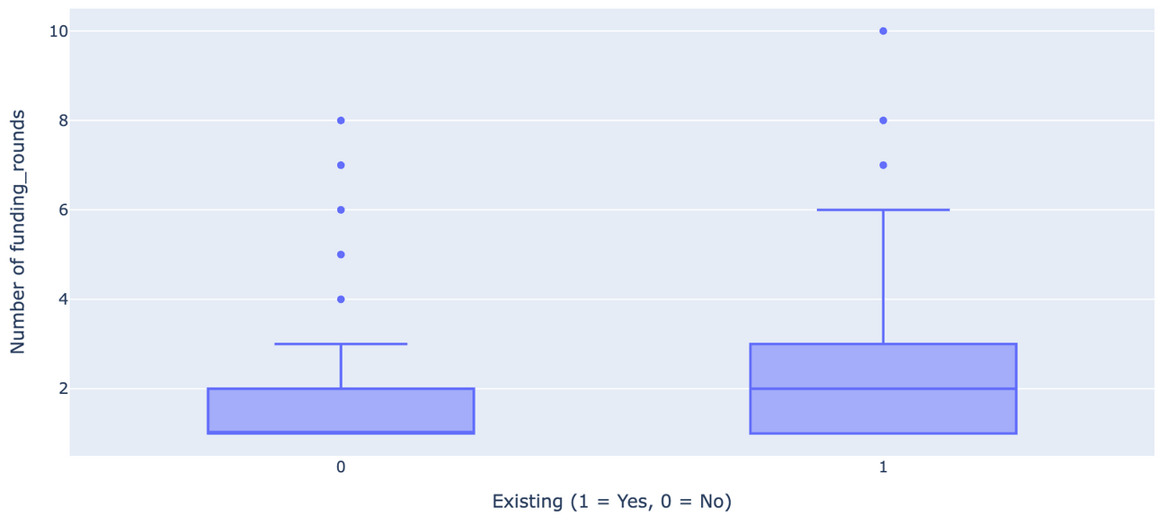
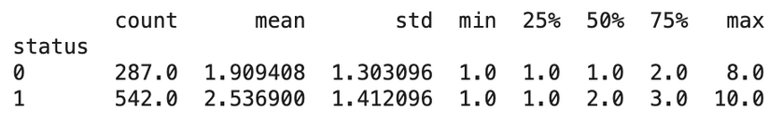
FUNDING ROUNDS VS. EXISTING STARTUP
Startups that still Acquired generally have more funding rounds (median = 2, IQR = 1–3)
Most Closed Startups only managed 1–2 funding rounds before shutting down. A few outliers raised up to 8 rounds but still failed probably due to high burn rate, poor execution, or bad market fit.
Acquired Startups typically raise more funding rounds than Closed Startups. Some reached very high fundraising levels (up to 10 rounds), which shows sustained investor support.
Startups with more funding rounds don’t necessarily mean higher success — it could reflect financial struggles requiring continuous fundraising, or it could mean strong growth attracting repeated investment.

Slide 24
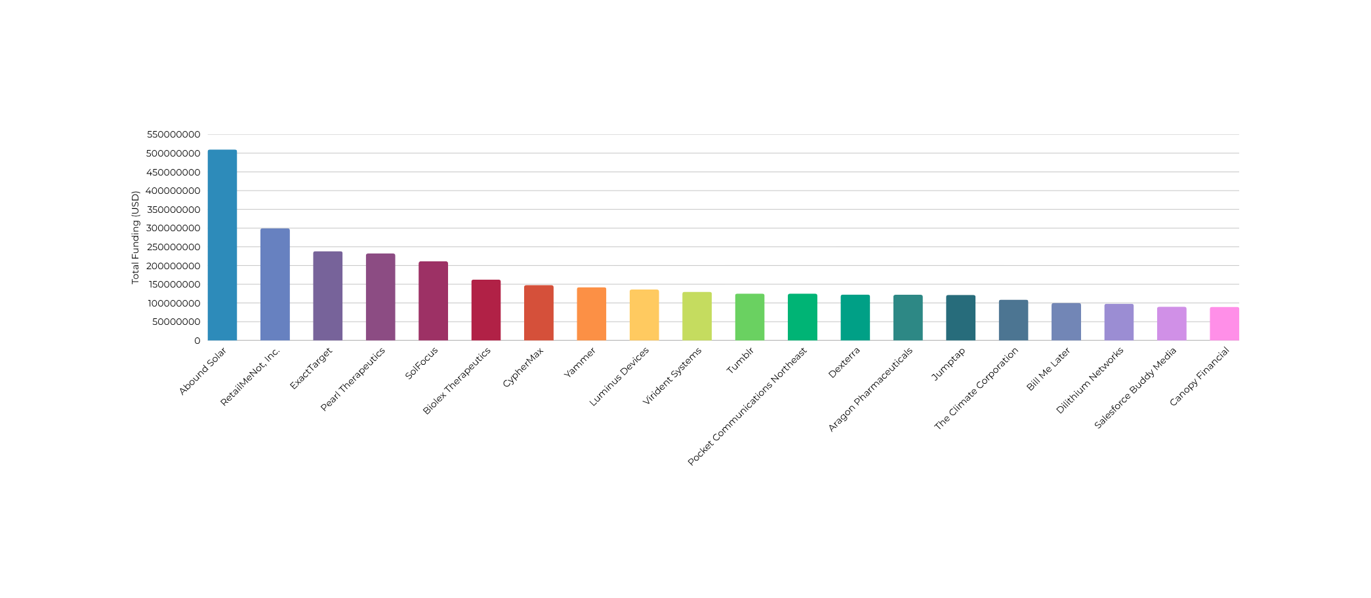
TOP 20 STARTUPS BY TOTAL FUNDING (IN USD)
Abound Solar dominates with $510M, far above the rest.
After that, the amounts gradually decrease, with most startups between $90M–$230M.
Several companies seem tied to renewable energy & cleantech. Abound Solar (with ~$510M), SolFocus, Luminus Devices, and others are biotech/pharma and consumer platforms.
Does High funding could prevent failure? Lets Find out !

Slide 25
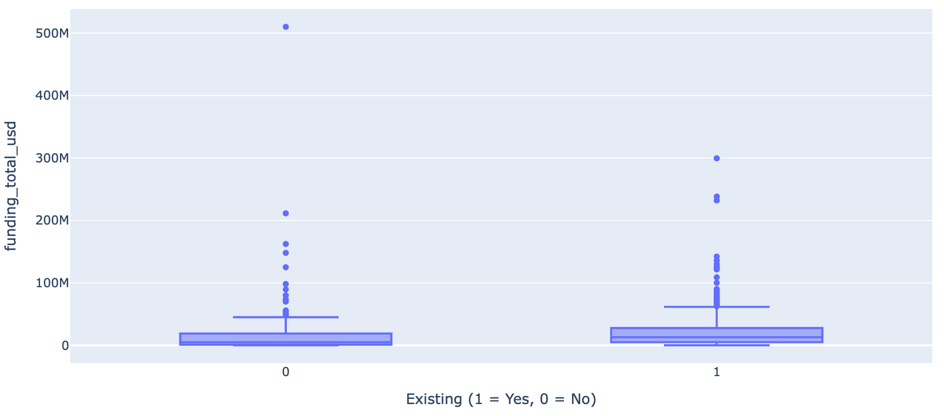
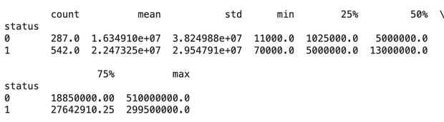
DOES TOTAL FUNDING ≠ SURVIVAL GUARANTEE.
The highest funding Abound Solar with $500M yet ultimately failed, means that large funding doesn’t guarantee long-term success
Both Acquired and Closed startups have a wide spread of total funding, indicating that ‘Not all big-funded startups survived’
Survival isn’t solely funding-driven, many well-funded startups shut down highlights the importance of business fundamentals (market fit, execution, adaptability) are more than just raising large amounts.
Some startups survive with relatively small funding, meaning efficient capital usage can be important

Slide 26
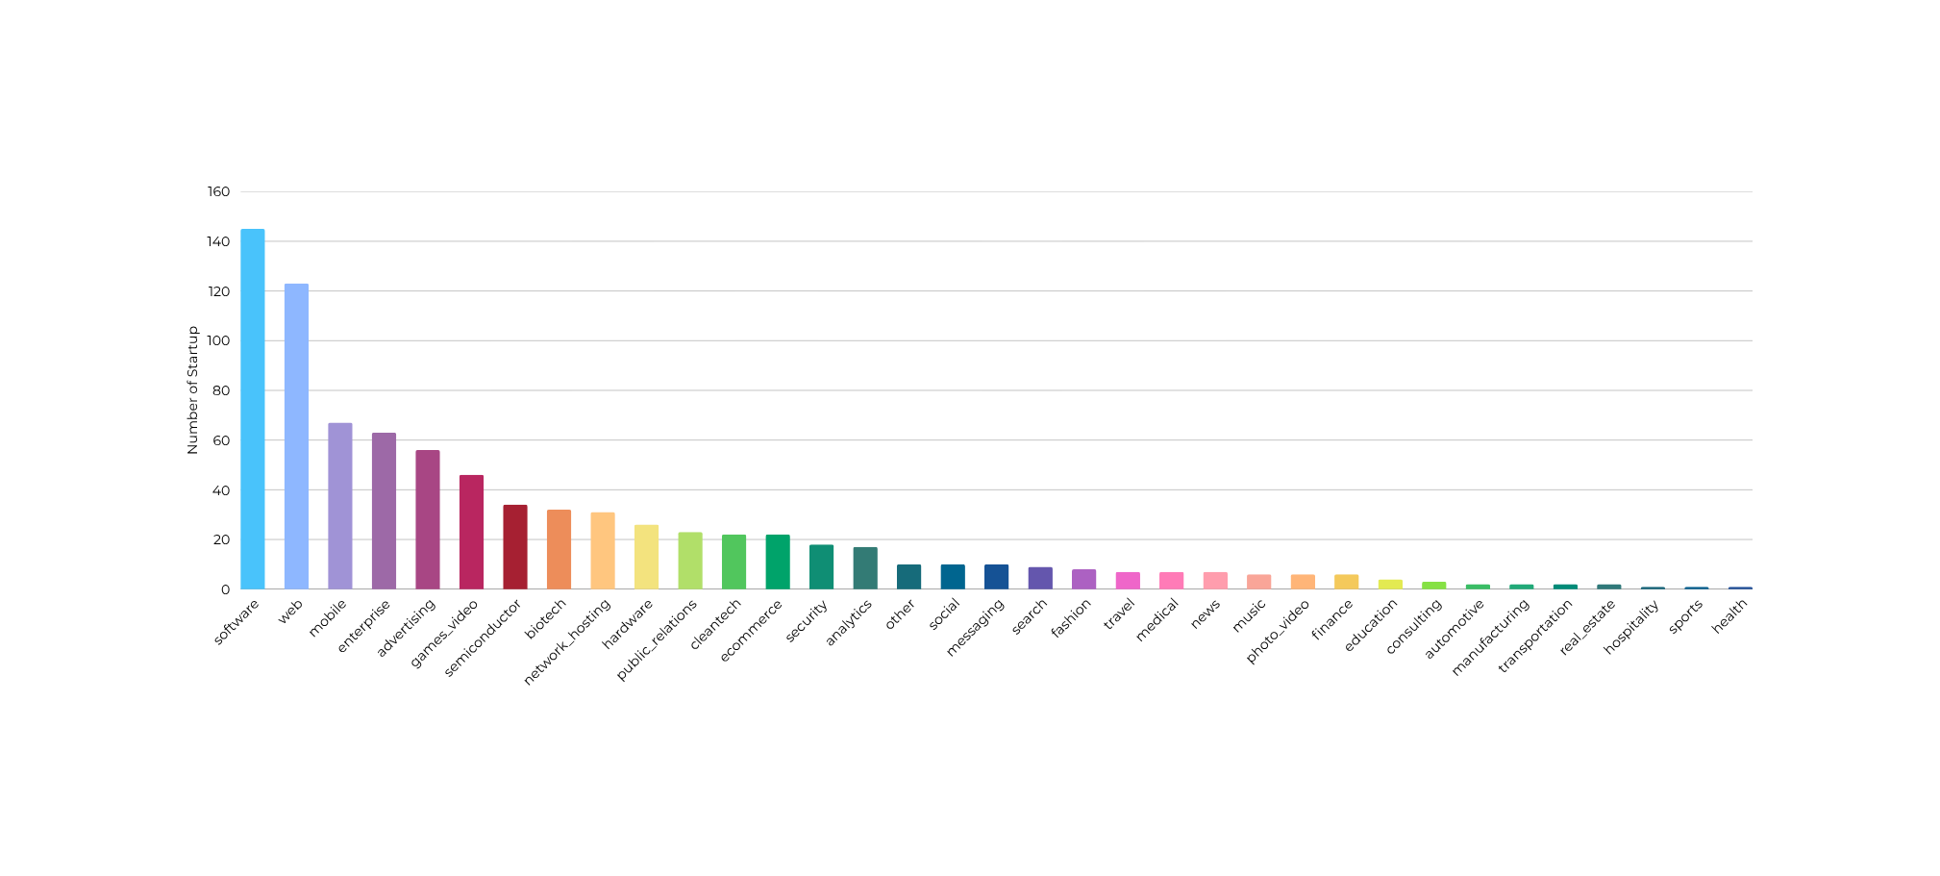
NUMBER OF STARTUP BY CATEGORY
Software and Web (145 and 120) are by far the largest categories. This suggests that the majority of startups are tech-driven, reflecting the relatively low entry barriers (e.g. fewer physical assets needed compared to biotech or manufacturing)
Mobile, Enterprise, Advertising, and Games have a strong presence.
Typical industry like: Semiconductor, Biotech, Network Hosting, Cleantech have smaller counts, Since they require higher upfront capital, technical expertise, and longer development timelines.
Sports, Health, Hospitality, Real Estate, Automotive, Consulting, Education have only a handful of startups.

Slide 27
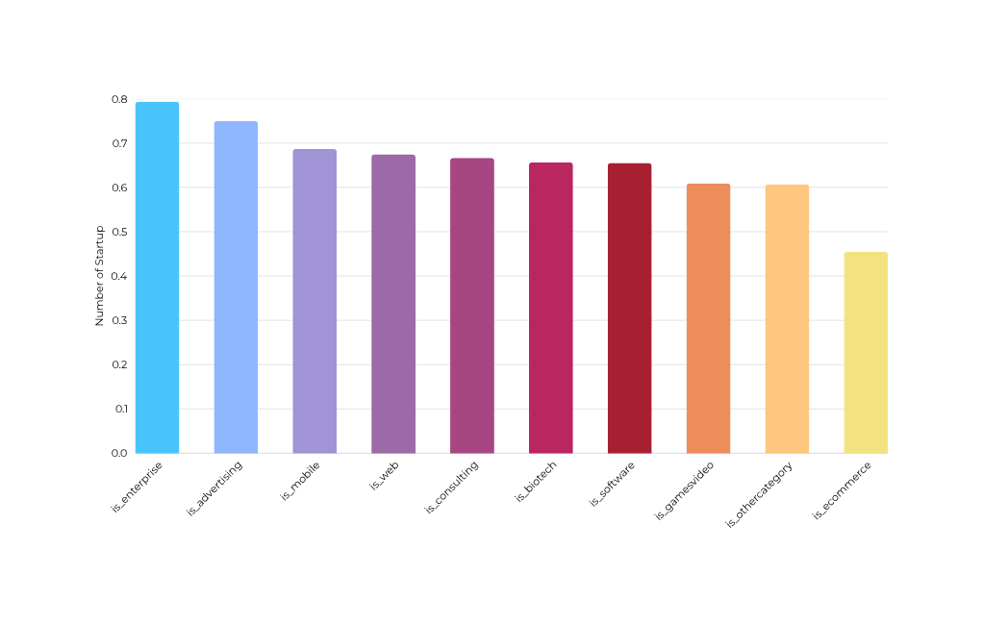
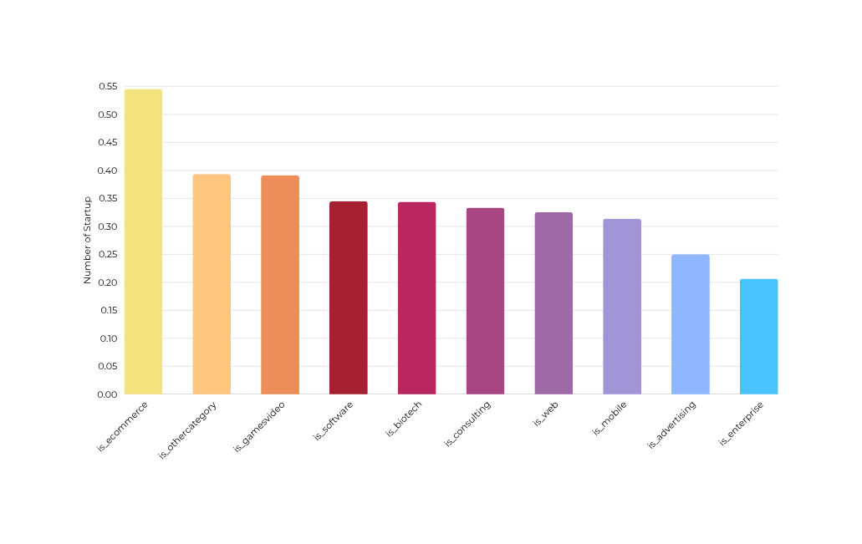
DOES THE CATEGORY OF A STARTUP INFLUENCE ITS LIKELIHOOD OF FAILURE ?
Proportion of Acquired Startups by Category
Proportion of Closing Startups by Category
Enterprise is the most resilient category with 79% survival rate and 20% closure rate followed by Enterprise, Advertising, and Mobile.
Web, Software, Biotech, Consulting = middle ground (moderate risk, moderate reward).
Games, Video and Other categories are weaker with survival 60% and closure near 40% remind these sectors are trend-sensitive and prone to volatility,
Investors should balance volume of startups with survival rates, as for E-commerce has many players but worst survival due to highly competitive with thin margins

Slide 28
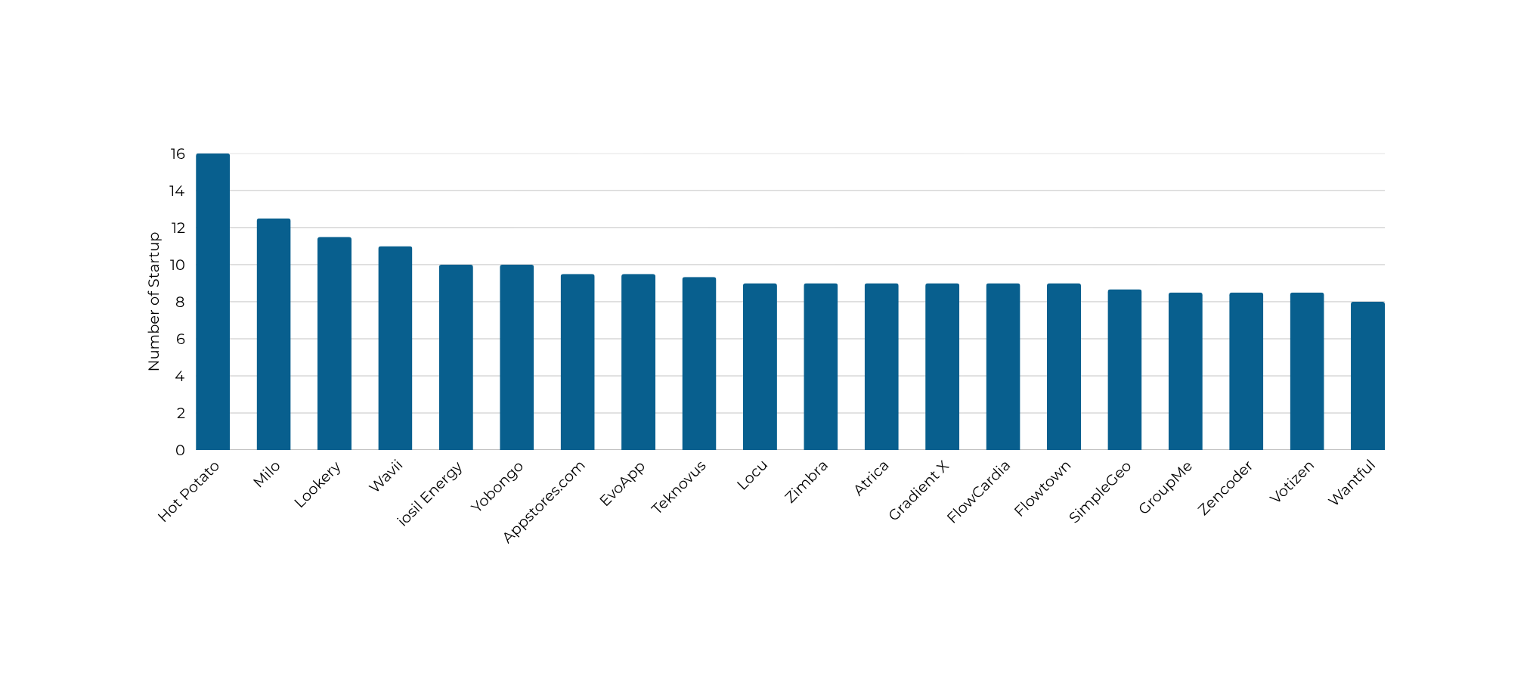
TOP 20 STARTUPS BY AVG_PARTICIPANT
Hot Potato stands out significantly with the highest average participants followed by Milo and Lookery.
The majority of the other startups cluster between 8 and 11 participants, showing a more typical range of investor involvement
A higher average participant count might signal greater investor confidence, stronger networking, or higher visibility in the market.

Slide 29
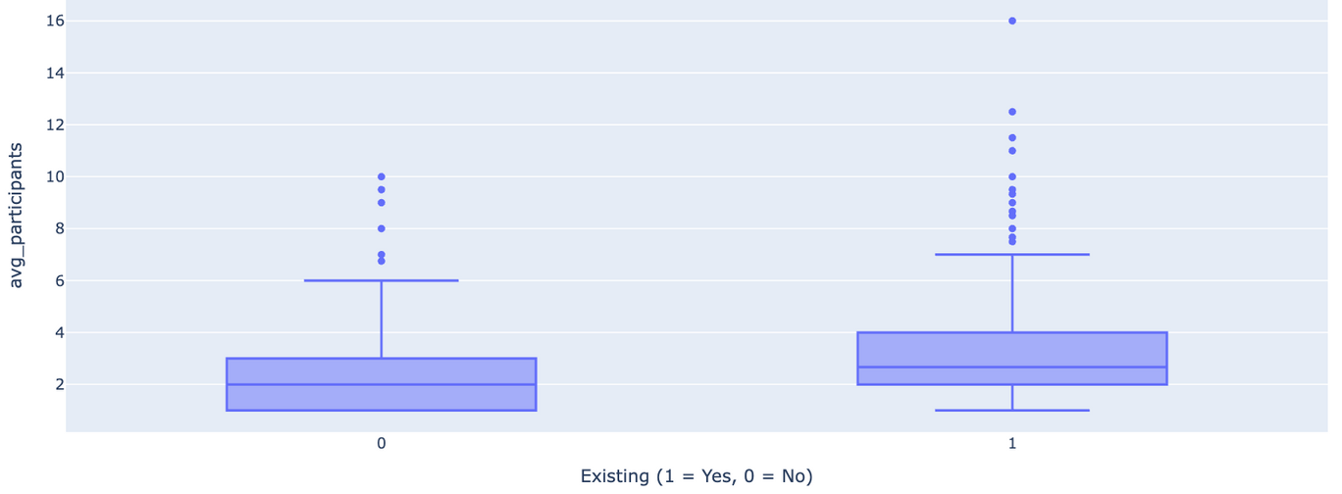
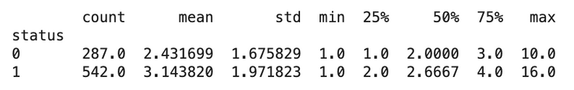
PARTICIPANT INVOLVEMENT VS ACQUIRED STARTUP
Participant count is positively associated with survival.
Average participants are higher for existing startups, mean participants 3.14 compared to closed startups~2.43.
A few Acquired Startups attracted 10–16 participants, way above the median, these may represent high-profile companies with strong participant involvement
Closed startups are concentrated around 1–3 participants while Acquired startups have doubled concentrated. and having more participants seems to increase the likelihood of a startup still existing.

Slide 30
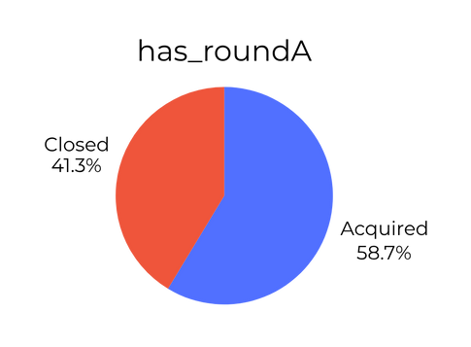
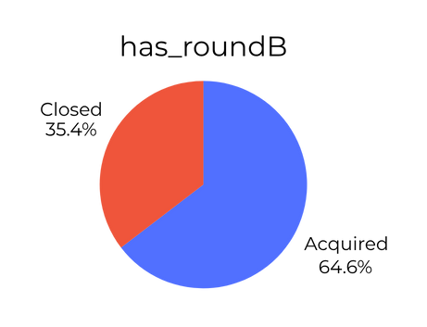
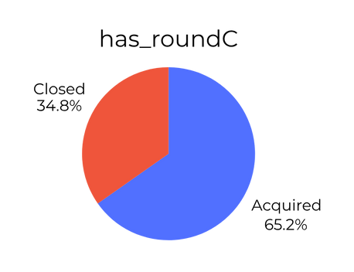
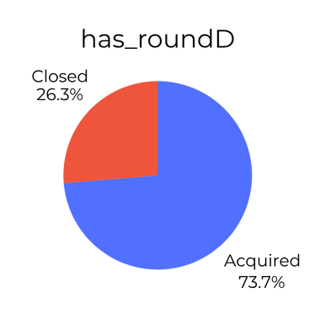
STAGES OF STARTUP LIFECYCLE: ROUNDS A, B, C, AND D (SURVIVAL FILTER)
As startups progress from Round A B C D, the acquisition rate increases, and the failure rate decreases.
has_roundA is early scaling, Startups here are still proving their business model viability.That’s why the failure rate is relatively high (41.3%)
has_roundB is growth phase, Startups that survive past A usually have traction, customers, and revenue growth, this explains why failure rate drops (35.4%)
has_roundC is scaling & expansion, Startups are well-established and often raise large amounts for acquisitions, the failure rate is now only 34.8%, showing much stronger survival chances.
has_roundD is Late-stage/pre-exit, These startups are often preparing for IPO, acquisition, or very large exits, hat’s why only 26.3% fail
Weaker startups fail early, while stronger ones survive and attract larger, later-stage funding.

Slide 31
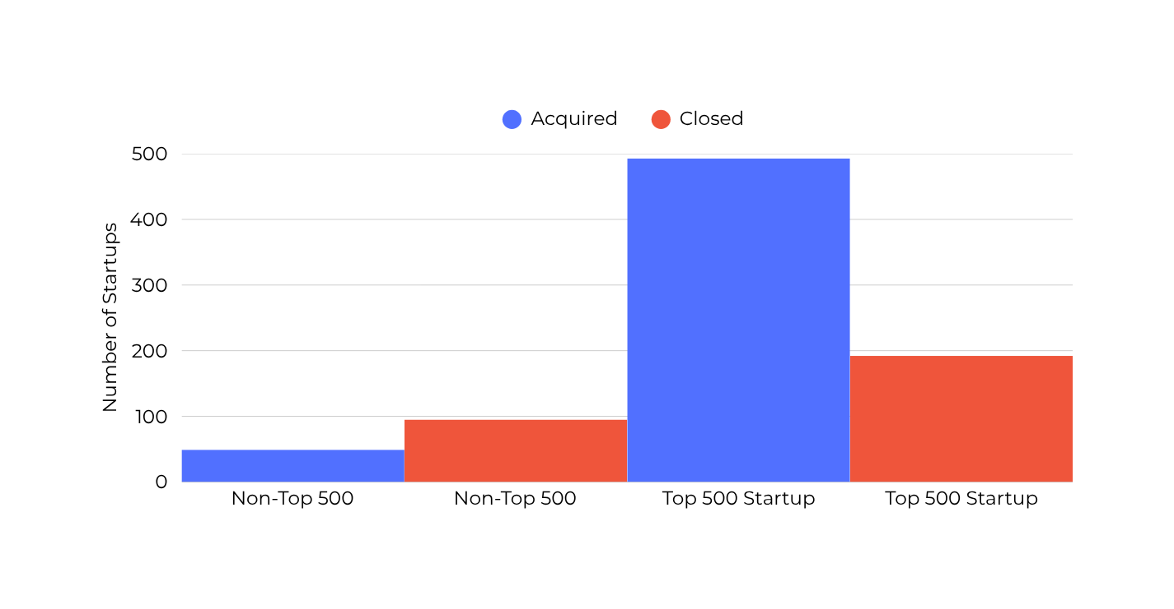
HOW MANY STARTUPS IN THE TOP 500 HAVE BEEN CATEGORIZED AS CLOSED OR ACQUIRED
500 Startups (500 Global) is a venture capital seed fund and accelerator headquartered in San Francisco, US. and it was co-founded in 2010 by Dave McClure and Christine Tsai.
490+ startups are survived and 190+ startup are failed in the TOP 500 category
Top 500 startups are far more likely to survive than those not in the list.
The failure rate is proportionally higher (red bar is almost double the blue bar) for Non–Top 500 startups
Top 500 recognition are can be strong predictors of startup success.

Slide 32
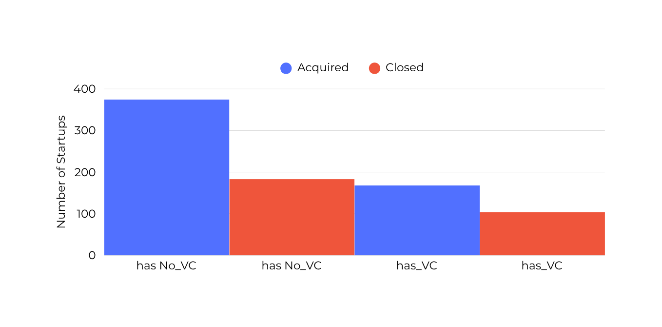
STARTUPS WITH VENTURE CAPITAL FUNDING
A large number of startups without VC funding ended up being acquired (374), means that many startups can reach successful exits without external VC funding.
Among startups with VC funding (167) were Acquired and (100) were Closed, but this proportion of acquisitions is still relatively strong., indicates VC funding improves survival chance.
VC-Funded Startups Have Higher Closure Rates (38%) than non-VC ones (33%), and Non-VC Startups Have Slightly Higher Acquisition Rates (67%) compared to VC-funded startups (62%).
By implementation VC funding may increase scale and visibility, but it doesn’t guarantee lower failure risk.

Slide 33
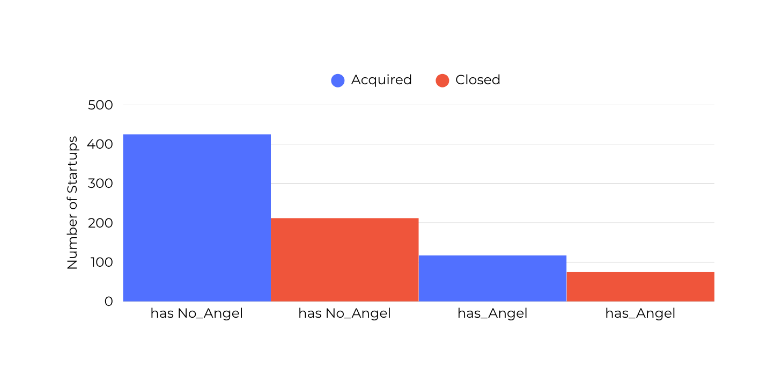
STARTUPS WITH ANGEL INVESTOR
Startups without Angel Investors slightly more successful in acquisitions (67%) compared to those with angel Investor (61%)
Otherwise Startup with Angel Investor show higher closure rates (39%) than non-angel-Investor (33%), this means Angel Investor may increase riskA
Angel Investor provides early capital but doesn’t guarantee higher survival/acquisition rates, since many Angel-Investor backed startups may still fail reaching acquisition.

Slide 34
DATA VISUALIZATION
NEW FEATURES
UNCOVERING KEY FACTORS INFLUENCING STARTUP SUCCESS

Slide 35
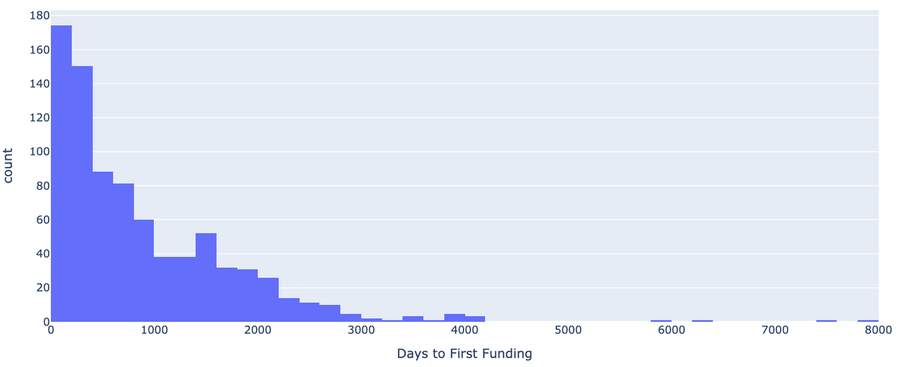
DISTRIBUTION OF TIME TO FIRST FUNDING
First Funding refers to the number of days elapsed from the company's founded until it secures its initial round of funding.
The majority of startups receive their first funding within the first 1000 days (3 years), this show typical early-stage funding cycle where investors back startups soon after founding.
After (3 to 5 years), the number of startups receiving first funding drops sharply, this suggests that if startups don’t raise early, it becomes increasingly difficult to attract investors.
There are rare cases where startups secure funding after 5000-8000 days (14years)
The Average Time to First Funding for Startups : is 884 days or 2.42 Years

Slide 36
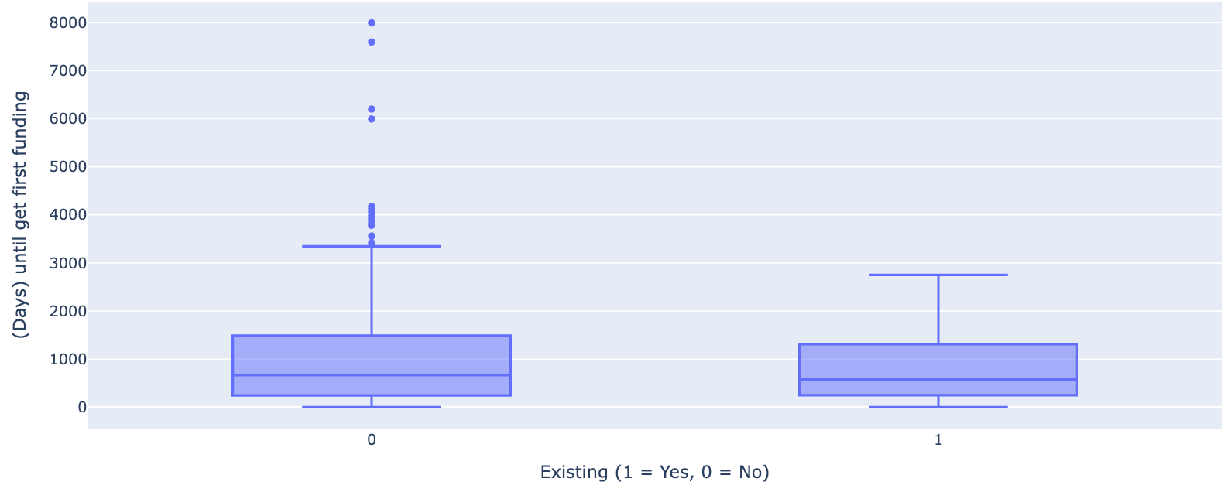
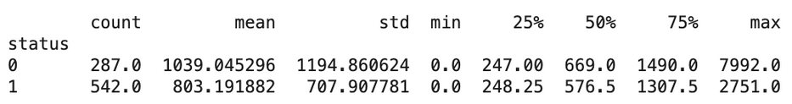
FIRST FUNDING VS ACQUIRED STARTUP
Faster funding lead to higher survival, since Acquired startups tend to secure funding earlier than those that closed.
Late funding increases risk of closure, since Closed startups show much more variability and delays in funding that could reduce survival chances.
Extreme cases of delayed funding (8000+ days) are heavily skewed toward Closed startups, reinforcing the idea that funding timing is critical.

Slide 37
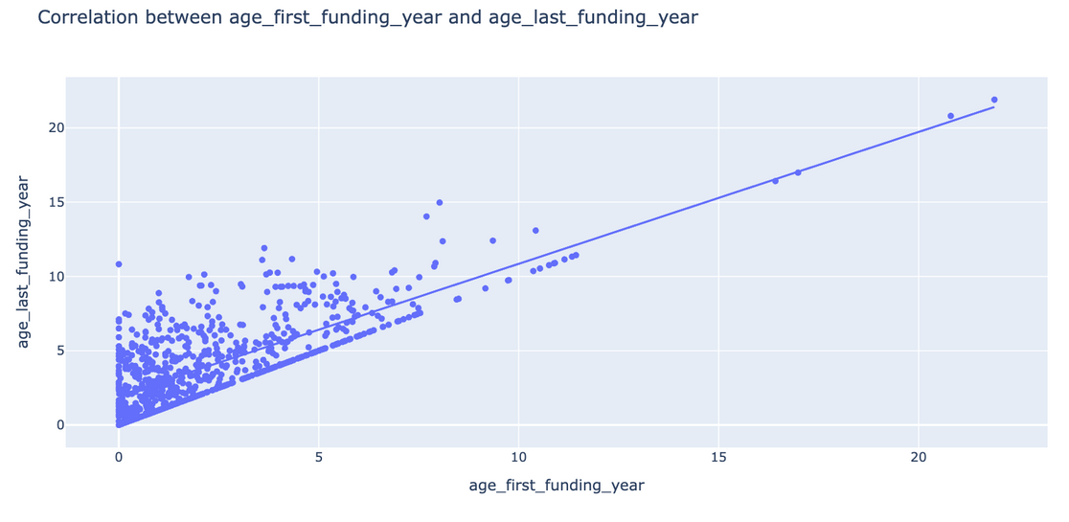
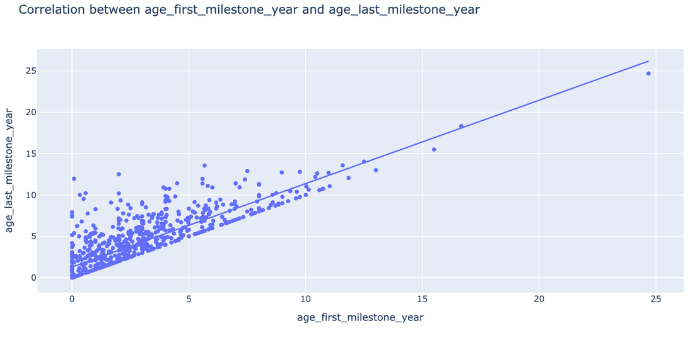
CORRELATION BETWEEN AGE_FIRST_FUNDING_YEAR AND AGE_LAST_FUNDING_YEAR
CORRELATION BETWEEN AGE_FIRST_MILESTONE_YEAR AND AGE_LAST_MILESTONE_YEAR
Strong positive correlation between age_first_funding_year and age_last_funding_year, means that receive funding earlier in their lifecycle also tend to continue raising funds for a longer period.
Some startups stretch far along the Y-axis, showing that they raised first funding early but continued fundraising for many years, showing long-term growth and sustainability.
Early access to funding doesn’t just help survival, t enables startups to stay in the funding cycle longer
Strong positive Correlation between age_first_milestone_year and age_last_milestone_year, can lead the Startups that hit their first milestones quickly after founding are more likely to maintain progress and attract later milestones.
Startups without early funding tend to struggle in both attracting later rounds and achieving long-term milestones.

Slide 38
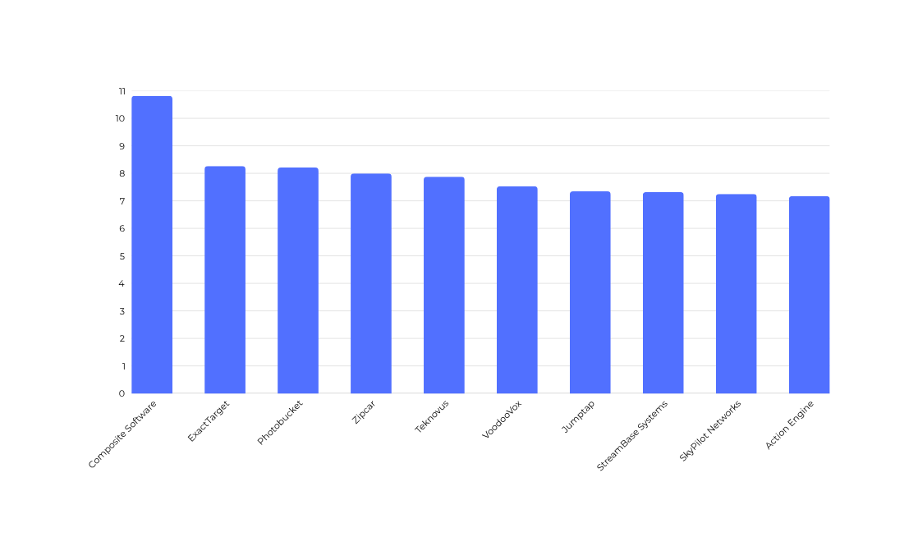
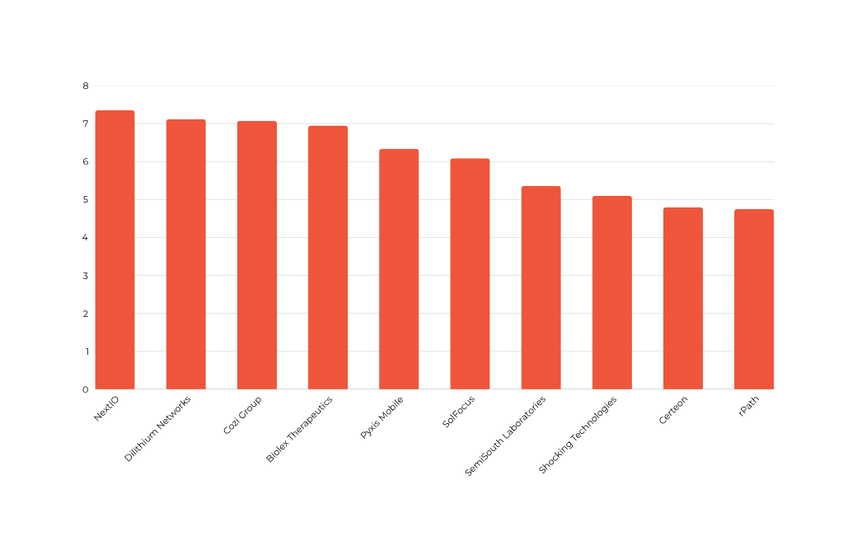
HOW LONG (IN YEARS) A STARTUP HAS BEEN ACTIVELY RAISING FUNDS?
Funding Age Overview of Acquired Startups
Funding Age Overview of Closed Startups
Funding_age = 0 → The startup only raised money once (first and last funding happened in the same year).
Funding_age > 0 → The startup had multiple funding rounds spread across time, so it was able to attract investors over several years.
Longer funding_age → Could indicate sustained investor interest, growth, or a longer fundraising lifecycle.
Shorter funding_age → Could suggest: the startup either got acquired/closed soon after raising,Or it raised a big round early and didn’t need additional funding,Or it failed to attract follow-up funding.
Average Startups actively raising funds is : 1.70 years

Slide 39
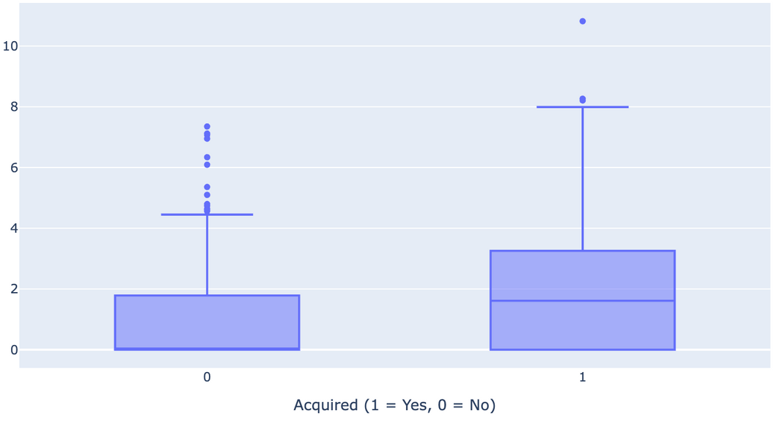
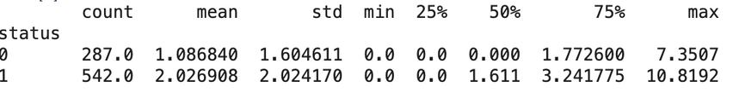
FUNDING AGE VS ACQUIRED STARTUP
Average fundraising Acquired = 2.0269 and Closed = 1.0868, Suggests that reaching at least ~2 years of sustained fundraising increases the probability
Acquired startups fundraise longer with Median 1.61 years, while for Closed startup is 0 years, this shows many Closed startups never fundraised
Closed startups mostly avoid or fail at fundraising, while Acquired startups typically engage in longer, more persistent fundraising cycles.
75% of Acquired startups fundraised for up to 3.24 years, compared to only 1.77 years for Closed.
Extreme outliers exist in both groups, as for Closed Startups fundraised up to 7.35 years but still didn’t exit and Acquired got fundraised for 10.8 years.

Slide 40
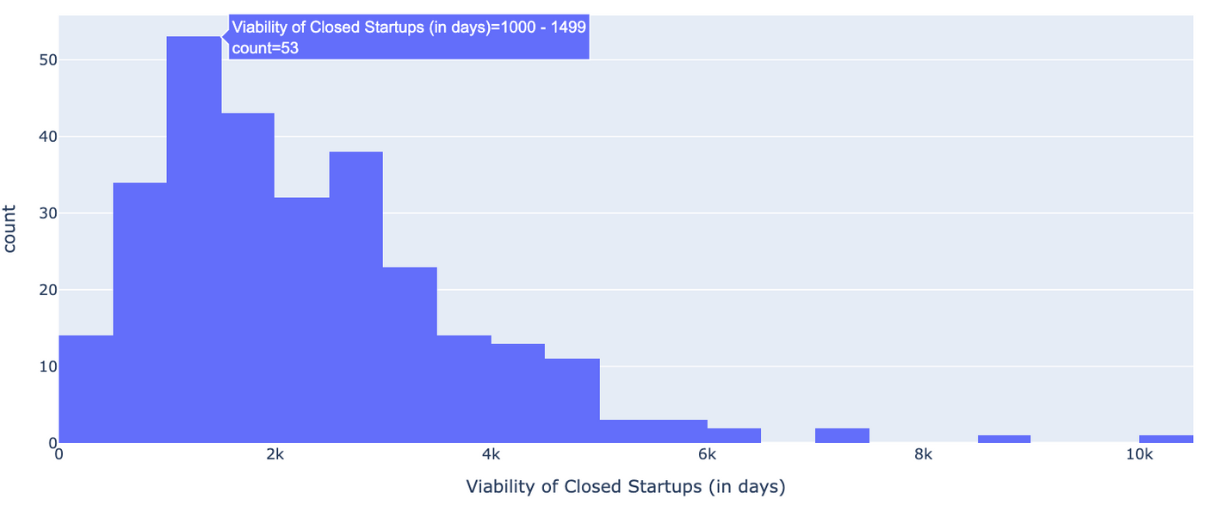
THE DISTRIBUTION OF VIABILITY UNTIL STARTUP CLOSED
Do 20% of startups fail within the first year?
Do 65% of startups fail within 10 years?
1.39% startups fail in the first year
16.72% startups fail in 3 years
83.97% startups fail in 10 years
58.89% startups fail in 6,5 years
Average lifespan of failed startups: 6.3 years
The majority of Closed Startups survive between 1000 to 3000 days (3 to 7 years) making this as critical window.
Few startups close within their first 500 days (1.5 years), most Startup can survive in the early “trial” stage
Few closed startups lasted 6000–10000 days (16–25 years) before shutting down. This illustrates that longevity does not guarantee survival, especially in the face of changing market conditions, intense competition, or an inability to adapt.

Slide 41
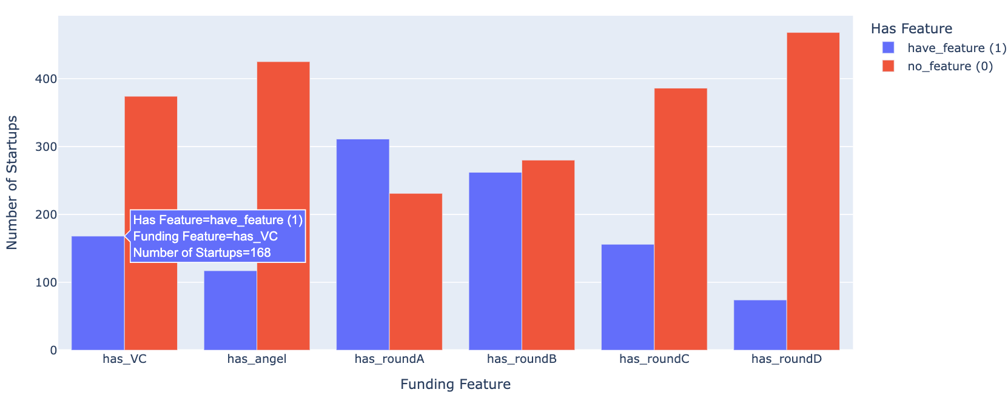
ALL FUNDING FEATURE ON ACQUIRED STARTUPS
At Early-stage Funding (VC and Angel) more startups Without VC (374) and Angel funding (425) compared to those with (VC=168, Angel=115). Many startups were able to grow without relying on VC and/or Angel Investors, indicating stronger resilience and independence.
More startups have Round A, suggesting this stage is a common of growth milestone.
The distribution is relatively balanced between startups with and without at Round B
Startups Without Rounds C and D dominate strongly. This shows that progressing to advanced funding stages is relatively rare or sustain themselves.

Slide 42
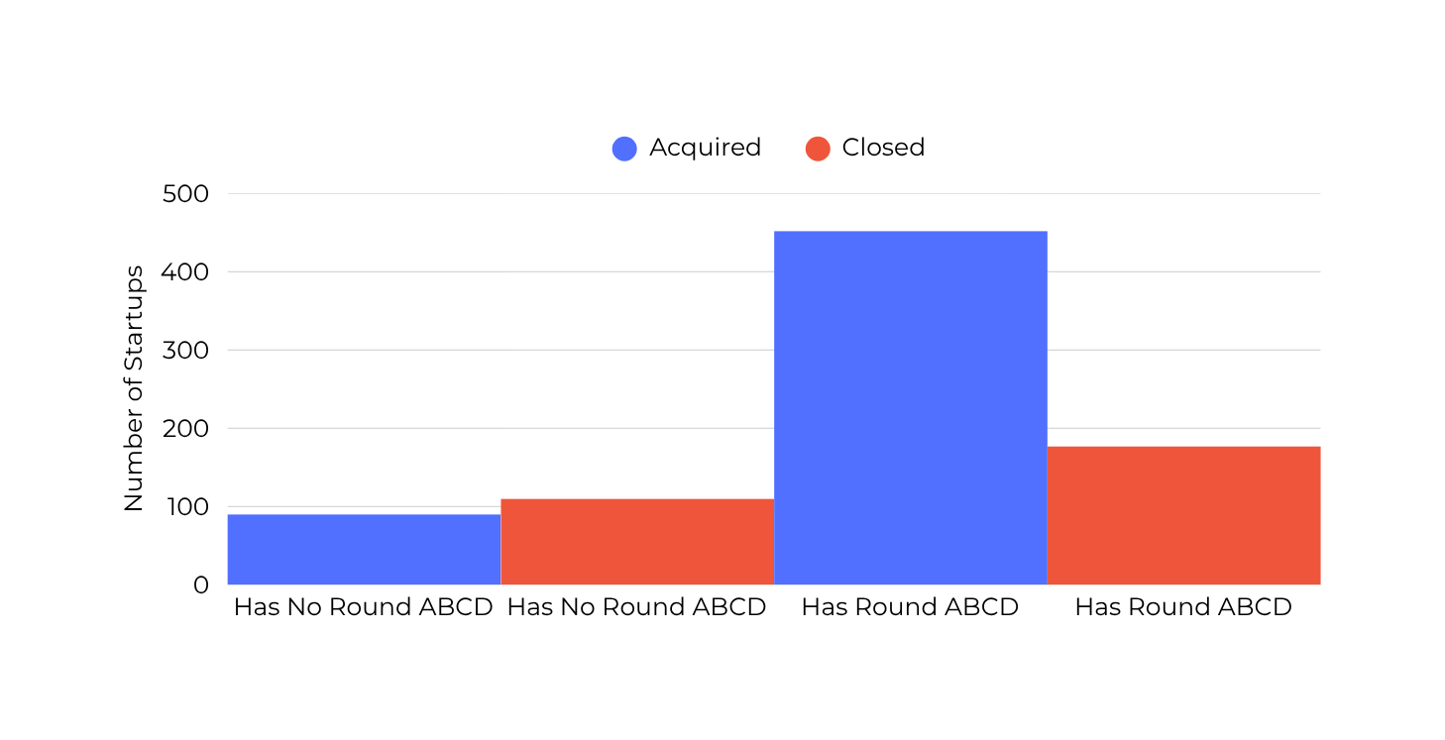
HOW MANY STARTUPS HAVE MULTIPLE ROUND (A,B,C,D)
Acquired Startups with Round A–D were dominates the population (452) indicating strong predictor of acquisition.
Startups didnot reach Round A–D are devided by Acquired=90 and Close=110. Most of them either stayed independent or shut down, also showing that early-stage startups face higher risks and fewer acquisition opportunities.
Ability to progress through structured Rounds (A–D) is strongly linked to successful acquisitions
Surviving to Rounds (A-D) lead to much higher acquisition chance

Slide 43
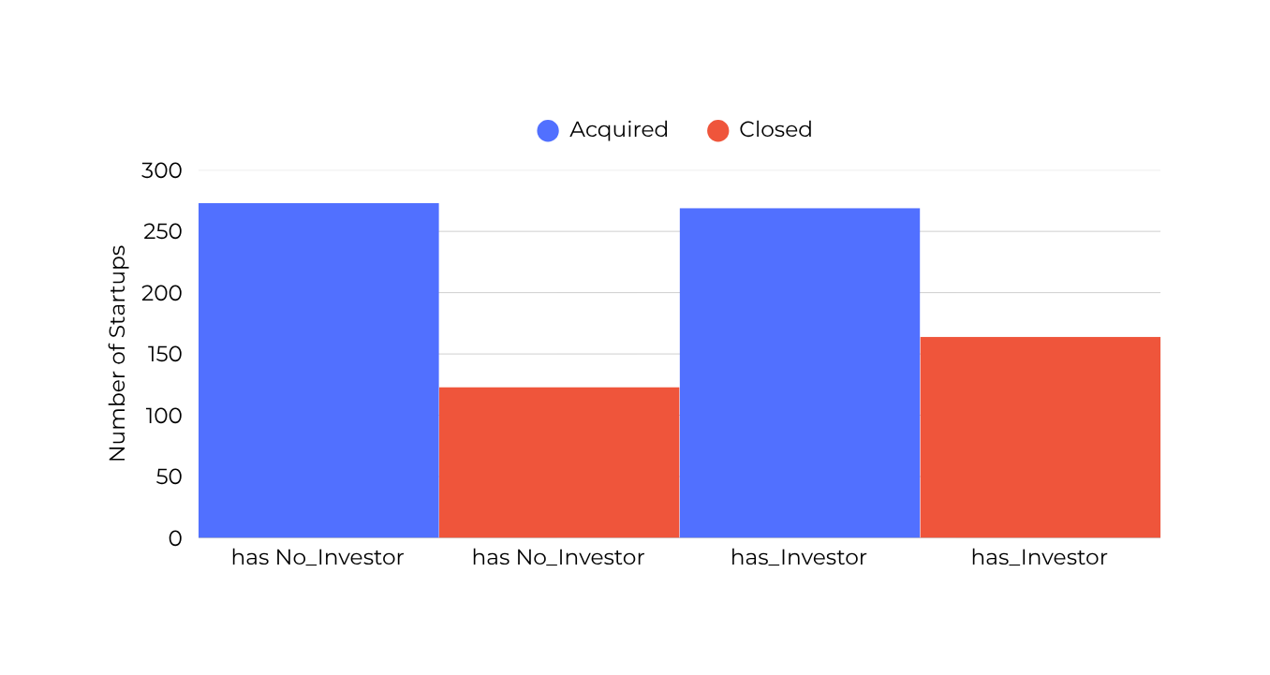
SECURE FUNDING FROM VENTURE CAPITAL & ANGEL INVESTOR ON STARTUP OUTCOMES
Both VC and Angel Investor have a high number of acquisitions (with VC & Angel=269 and Without VC & Angel =273), showing that Startups can succeed with or without combined VC and Angel Investor
Closure rate is higher for startups with both Have VC and angel funding (184) than without (123), this suggests that while VC and angel investments inject early capital, they may also add external pressures
Startups Without VC and Angel Investors often show stronger resilience and lower closure rates.
Dual-investor VC and Angel Investor accelerated growth but with significantly higher failure risk.

Slide 44
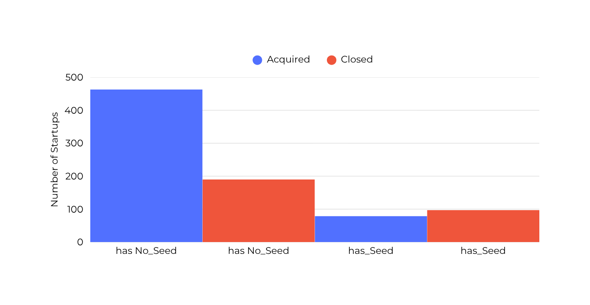
HOW MANY STARTUPS HAS SEED ASPECTS: HAS VC, HAS ANGEL, HAS ROUND A,B,C,D
Startups Without structured Seed (no VC, no angel, no Rounds ABCD) show much higher acquisition success., indicating Seed-funded startups are not necessarily stronger
Startups With Seed aspects experience higher closure risk and relatively low acquisition outcomes.
Heavy involvement of seed funding (VC,Angel,Rounds ABCD) may inflate valuations and risk
Startups that grow more organically (Without structured Seed packages) are more sustainable.
With alternative growth paths (bootstrapped, strategic partnerships, customer-funded models) seem to lead to better and potential.
Overfunding may lead to inflated growth, unrealistic expectations, and eventual collapse.

Slide 45

HOW MANY STARTUPS CLASSIFIED AS ‘NON-FUNDED STARTUPS’
Funded Startups on Acquired reached = 531, in contrast Non-Funded Startups barely appear = 11 on Acquired.
274 Funded startups still Closed prove that funding provides resources to grow, but it does not eliminate risk.
Non-funded startups (bootstrapped) show very few (Aquired=11, Closed=13) prove that organic growth may still succeed, but without external funding makes it harder to achieve acquisition scale, as they often remain small or localized.
The dataset mirrors real-world Startup’s ecosystems:
Globally, most acquisitions involve funded startups, while non-funded ones either grow slowly in the markets or shut down quietly.
Acquiring companies (larger firms, corporates) tend to prefer Startups that already have VC or Angel, since funding is seen as a form of due diligence and growth validation.

Slide 46

DATA CORRELATION MAPPING
Base on General Benchmark for Correlation, a value of 0.60 – 0.79 → is classify as Strong correlation, and we found it as follows:
1. has_VC ↔ has_Investor: 0.6654 → Strong positive correlation, this due to startups with VC usually have investors
2. has_RoundABCD ↔ Non_Funded_Startup: –0.9208 → Very strong negative correlation, because once a startup is non-funded, it definitely won’t have Round A/B/C/D.

Slide 47

BOXPLOTS OF SELECTED NUMERIC COLUMNS
Outliers:
Log-transformation of the Features 'funding_total_usd' so the model doesn’t get dominated by mega-funded startups.
And leave the other features as it is, because of small integers (0–20) not extreme enough to need log.
Scaling:
We use Standard Scaler for scaling the data.

Slide 48
PREDICTIVE MODELING TECHNIQUES

Slide 49



LGBM CLASSIFIER
CONFUSION MATRIX
Accuracy predicts the outcomes of 80%
Precision= 0.85 and Recall= 0.84 on Acquired Startups → gives strong reability and positive trust.
Precision= 0.71 and Recall= 0.72 on Closed Startups → making about 28% actual closures are missed, should not rely on the model alone for risk control
True Closed (41) = Correctly Identify Closed Startups
False Positive (16)= Predicted ‘Acquired’ but actually ‘Closed’- dangerous for investor
False Negative (17)= Predicted ‘Closed’ but actually ‘Acqiured’- missed opportunities (potential gains lost)
True Acquired (92)= Strong accuracy in detecting Acquired Startups.

Slide 50


XGBOOST CLASSIFIER
CONFUSION MATRIX
The Accuracy 78% is slightly lower than LGBM
Precision= 0.82 and Recall= 0.86 on Acquired Startups → the model is reliable for identifying acquisition
Precision= 0.71 and Recall= 0.63 on Closed Startups → the model more struggles to detect closures, 37% ‘Closed’ startups may be incorrectly flagged as ‘Acquired’
XGBoost is Stronger at finding acquisitions but weaker at closures.
True Closed (36) = Correctly predicted Closure
False Positive (21)= Predicted ‘Acquired’ but actually ‘Closed’- dangerous for investor (overestimating success)
False Negative (15)= Predicted ‘Closed’ but actually ‘Acquired’-risk of missing good opportunities.
True Acquired (94)= Correctly predicted ‘Acquired’ startups.

Slide 51


GRADIENT BOOSTING CLASSIFIER
CONFUSION MATRIX
The Accuracy 79.5% nearly balance as LGBM
Precision= 0.83, Recall= 0.86 F1Score= 0.85 on Acquired Startups → useful for investment targeting.
Precision= 0.72 and Recall= 0.67 on Closed Startups → Similar to XGBoost, closure detection is weaker, some risky startups slip through as ‘Acquired’
Gradient Boosting provides a solid middle ground—nearly as balanced as LGBM, but slightly weaker at closure detection.
True Closed (38) = Correctly predicted Closure
False Positive (19)= Predicted ‘Acquired’ but actually ‘Closed’- misclassifications for investors.
False Negative (15)= Predicted ‘Closed’ but actually ‘Acquired’ - missed identifying real Acquired
True Acquired (94)= Correctly predicted ‘Acquired’ startups.

Slide 52


ADA BOOST CLASSIFIER
CONFUSION MATRIX
The Accuracy 81% is slightly better than the Gradient Boosting
Precision= 0.82, Recall= 0.90 F1Score= 0.86 on Acquired Startups → very good at identifying ‘Acquired’ Startups
Precision= 0.77 and Recall= 0.63 on Closed Startups → some failing startups might be predicted as acquisitions.
Ada Boost performs consistently across classes, but slightly favors the majority class ‘Acquired’.
True Closed (36) = Correctly predicted Closure
False Positive (21)= Predicted ‘Acquired’ but actually ‘Closed’-Model thought a failing startup would succeed
False Negative (11)= Predicted as ‘Closed’ but actually ‘Acquired’ - missed opportunity
True Acquired (98)= Correctly predicted ‘Acquired’ startups.

Slide 53


LOGISTICS REGRESSION
CONFUSION MATRIX
The Accuracy 77% is the worst overall
Precision= 0.79, Recall= 0.89 on Acquired Startups → very strong, good catching at ‘Acquired’
Precision= 0.72 and Recall= 0.54 on Closed Startups → risky for failure prediction (important for risk management).
LR is less accurate and more prone to misclassifying Closed startups as Acquired. This makes it useful as a baseline model, but for higher reliability, ensemble methods are clearly better choices.
True Closed (31) = Correctly predicted Closure
False Positive (26)= Predicted ‘Acquired’ but actually ‘Closed’
False Negative (12)= Predicted as ‘Closed’ but actually ‘Acquired’
True Acquired (97)= Correctly predicted ‘Acquired’ startups → good at catching acquisitions, similar to AdaBoost

Slide 54


RANDOM FOREST CLASSIFIER
CONFUSION MATRIX
The Accuracy 82,5% is robust performance overall.
Precision= 0.83, Recall= 0.92 on Acquired Startups → strong reliability in positive predictions.
Precision= 0.80 and Recall= 0.65 on Closed Startups → 65% of actual Closed startups, meaning 35% are missed (Acquired)
Random Forest very strong at recognizing successful (Acquired) startups, but it misses a significant portion of Closed startups (35%), which means it’s not fully reliable
True Closed (37) = Correctly predicted Closure
False Positive (20)= Predicted ‘Acquired’ but actually ‘Closed’
False Negative (9)= Predicted as ‘Closed’ but actually ‘Acquired’ → more ‘optimistic’ on predict a startup as Acquired even if it’s actually Closed.
True Acquired (100)= Correctly predicted ‘Acquired’ startups → very strong detecting ‘Acquired’

Slide 55

ROC- AUC
ROC-AUC is a better metric than accuracy for imbalanced datasets (like Startup Acquired vs Closed)
AUC-ROC for LGBM: 0.8356671495251892
AUC-ROC for XGBosster Classifier: 0.8290680830516659
AUC-ROC for GradientBoosting Classifier: 0.8424271688395301
AUC-ROC for AdaBoost Classifier: 0.8798487043296315 → most powerful discriminator, lets improving it further with SMOTE and HPT
AUC-ROC for Logistics Regression: 0.8441976500885241
AUC-ROC for Random Forest Classifier: 0.8374376307741832

Slide 56



SMOTE + ADABOOST
SMOTE helped the model become fairer between ‘Closed’ and ‘Acquired’ by synthetically generating minority samples (Closed startups), this forced AdaBoost to learn more evenly across both outcomes
ROC-AUC should stay strong, but maybe even slightly improve (still on top performer)
SMOTE should reduce bias toward the majority class ‘Acquired’
AdaBoost now detects ‘Closed Startup’ more effectively on Recall (from 0.63 to 0.72), this is an important improvement for early detection of potential startup failure
The Accuracy might dip slightly, but balanced recall across classes will make it a more trustworthy model.

Slide 57


HYPERPARAMETER TUNING - ADABOOST
Hyperparameter tuning improved overall performance slightly better than the baseline AdaBoost (Accuracy= 0.81, AUC= 0.87) and clearly stronger than the SMOTE version (Accuracy= 0.78, AUC= 0.86).
Confusion matrix showed that the tuned model correctly classified most ‘Acquired startups’ (98) and improved the detection of ‘Closed Startups’ (40) without oversampling.
The balance between false positives and false negatives is healthy, the model prioritizes identifying Acquired startups and maintaining reasonable accuracy on Closed failure detection.
AdaBoost with HPT model emerges as the most robust and reliable among all tested algorithms ;
It preserves high predictive accuracy,
Improves the balance between both Acquired and Closed
And achieves an excellent AUC-ROC of 0.875, confirming strong discriminative power even in the presence of mild class imbalance.

Slide 58

FEATURE IMPORTANCE FOR BEST MODEL
Relationships (+0.158) is most influential feature by far, almost 4× stronger impact than the next one. Removing this feature reduces model performance significantly.
Startups with strong connections (partners, investors, advisors) are far more likely to Acquired or Survive.
Age First Funding Year - Startups that secure funding sooner after founding show higher resilience and acquisition chances.
Funding Total USD - higher funding increases survival and acquisition probability.
Average Participants - Reflects how many investors typically join each round.
is_top500 - Reputation and ranking slightly improve acquisition odds, possibly through visibility and trust effects.
Funding Rounds - Number of rounds contributes to stability and growth perception.
Age First Milestone Year - milestones (e.g., product launch, partnerships) slightly improve predictions.
has_roundD, has_roundC, has_angel - has minimal impact in the model. Specific late or early round types (or having an angel investor) don’t independently drive prediction when aggregated funding and relationships are already captured.
The drop-out loss analysis confirms that startup connectivity and timing of early funding are far more influential than the total number of rounds or investor types.

Slide 59


THANK YOU
Thank you for your attention throughout this presentation on ‘Startup Failure Analysis’.
Your feedback is crucial, please share any suggestions for my improvement.

